Slide 1

Representation Powers
and
Mandates
RPaM
DIGIT
2nd Working Group Meeting
31st January 2019

Slide 2

Agenda
RPaM Working Group Meeting #1
Content
Round Table
Meeting objectives
Next WG sessions
Questions and suggestions (WG members)

Slide 3
1
Round
Table

Slide 4


1
Round Table
DIGIT and MS
everis team
European Commission
Miguel Álvarez-Rodríguez (DIGIT, project owner)
Frédéric Poels (DIGIT, project owner)
Carlos Gómez-Muñoz (DG CNNECT, project owner)
Valentin Mesaros (DIGIT, analyst)
Member States and Stakeholders:
everis
Virginia Gomáriz (client manager)
Rui Venâncio (project manager)
Enric Staromiejski (eGovernment and interoperability)
Laia Bota (semantics analyst)
Danae Djin Ah Armelle Desplanques (business analyst)
Jade Maana (developer)

Slide 5
2
Meeting objectives

Slide 6
2
Meeting objectives
Recap on the previous WG-Meeting
Reminder on the overall objective
On-going activities
Progress made
Specific requests to the WG members
Road-map and prioritizing tasks

Slide 7
3
Recap

Slide 8
3
Recap of the previous WG meeting
Tools for collaboration:
GitHub:
Landing page
Issues
eMail: rpam-wg@everis.com
Glossary:
Use of the Issues for the improvement of the thesaurus
Maintenance by the RPaM development team (Excel)
Use Cases and Scenarios:
Documentation online
RPaM Ontology (Data Model):
Access to the descriptive page and the EAP file
Use of the issues for the improvement of the Conceptual Data Model and unitary tests
Main objective of this project (reminder):
To come up with a common RPaM Domain Ontology
Identify solutions for the federation and interoperability of Mandates

Slide 9
4
Ongoing
activities

Slide 10
4
Ongoing activities
New branch 1.1.0 created in GitHub
Mapping the MS information Requirements to the RPaM Ontology
RPaM Ontology evolution
Mandate
Request
Response
Needs and rules:
Identifying business domain and technical needs and rules

Slide 11
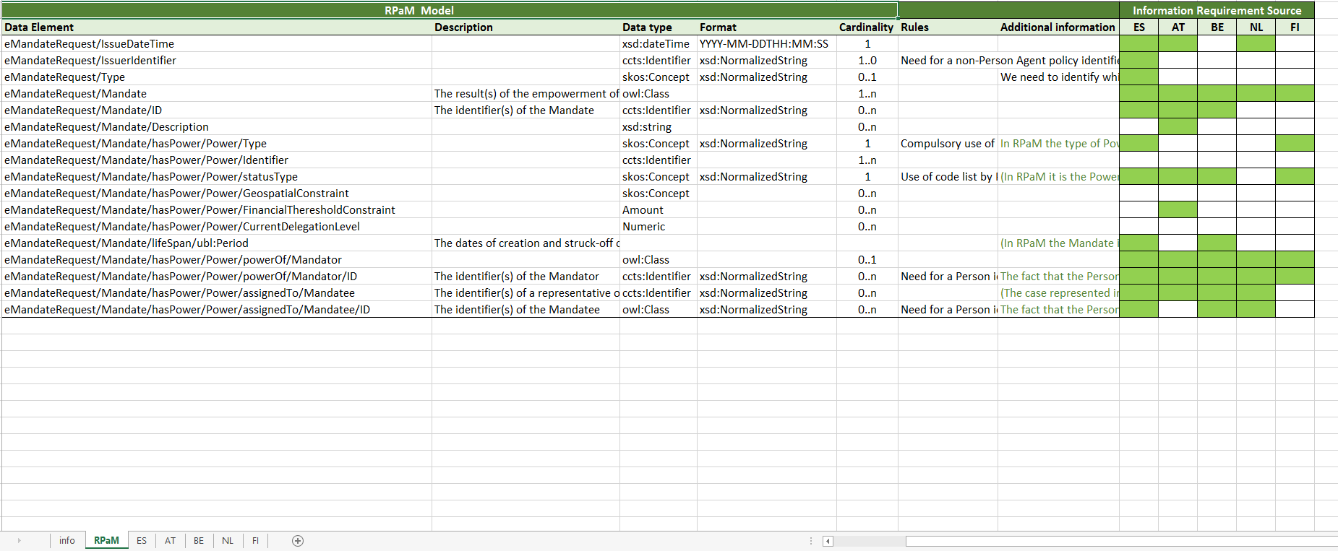
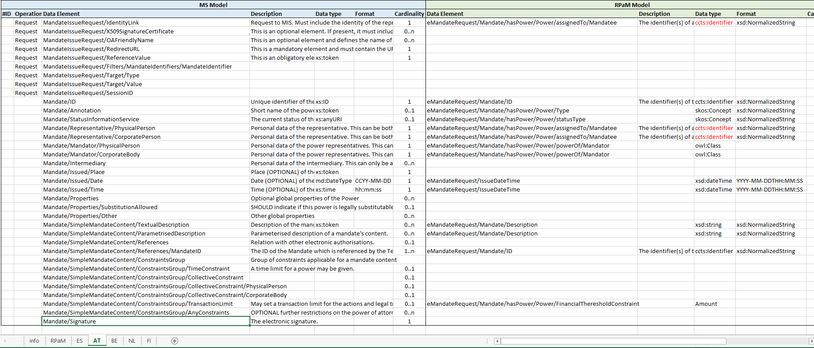
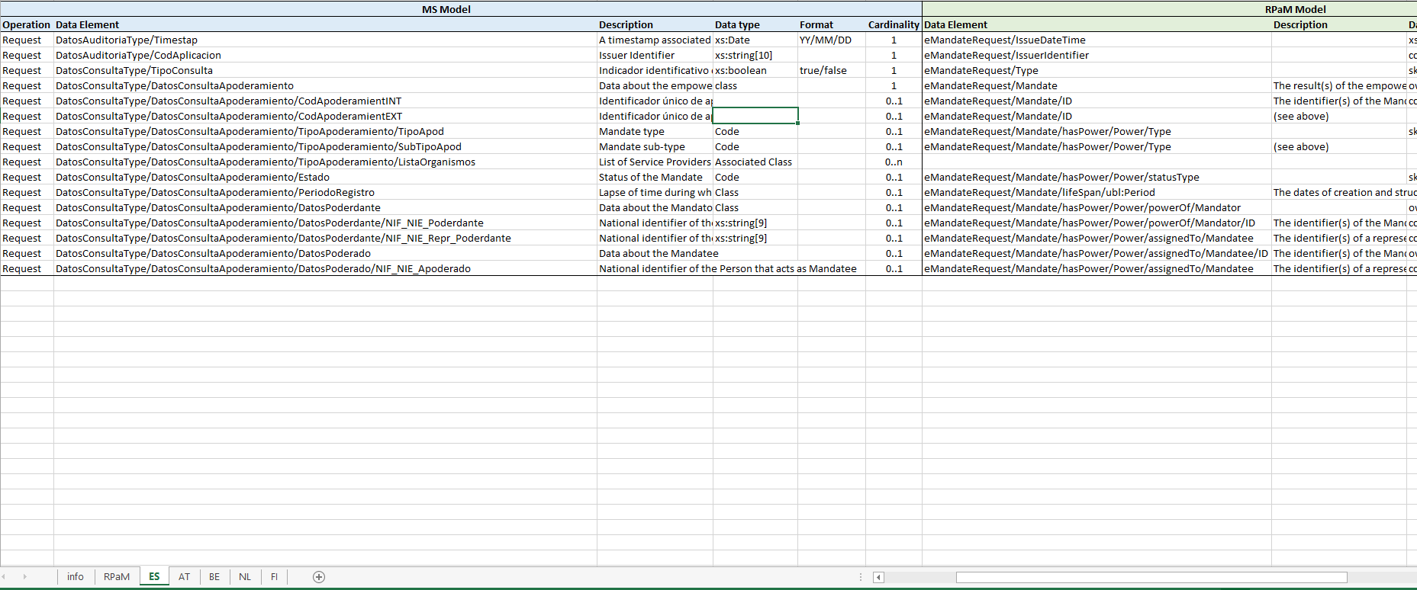
4
Ongoing activities: mapping IRs

Slide 12
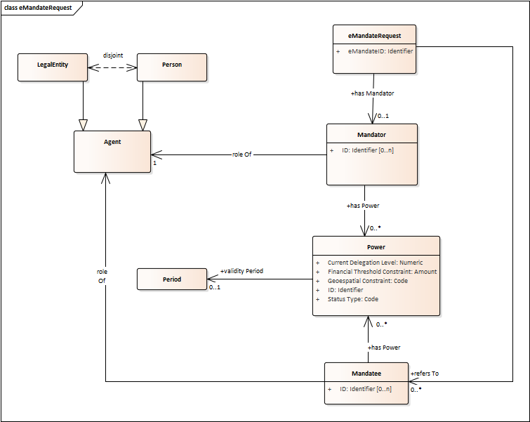
4
Ongoing activities: RPaM Ontology previous
V1.0.0

Slide 13
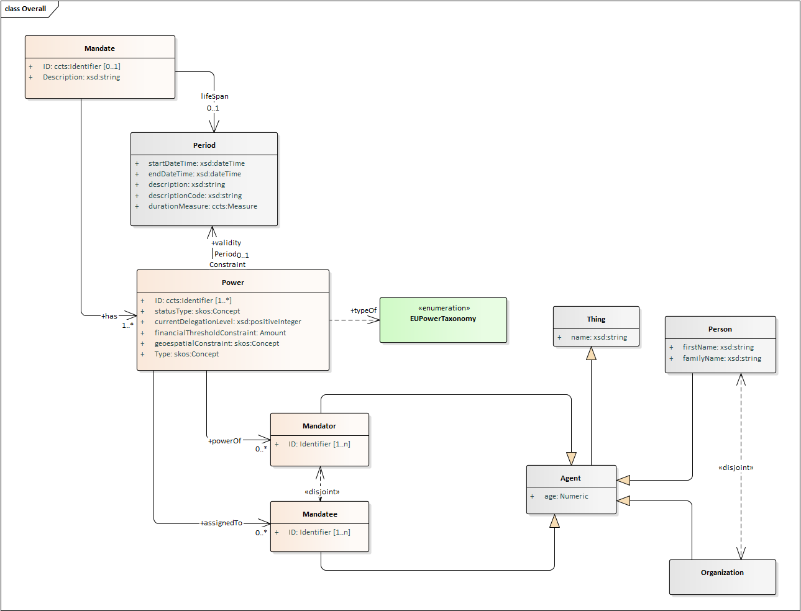
4
Ongoing activities: RPaM Ontology evolution
V1.1.0

Slide 14
5
RPaM eBusiness Documents (1/4)
Old model

Slide 15
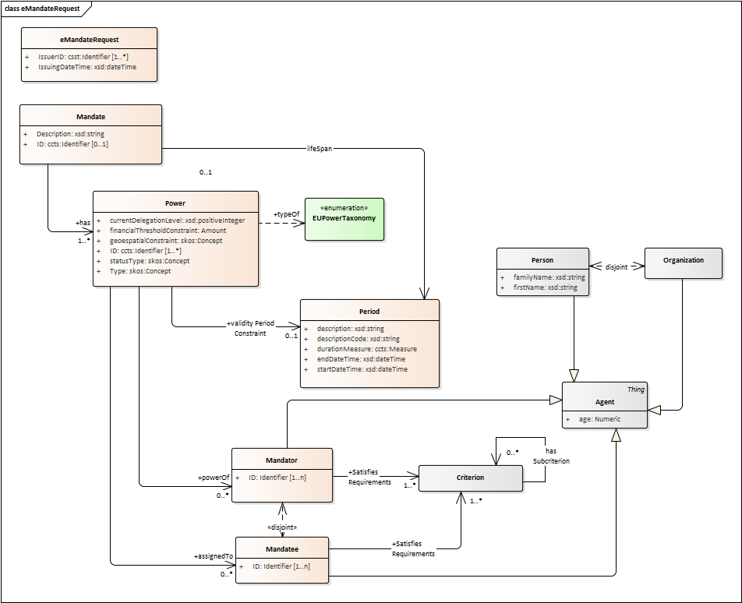
5
RPaM eBusiness Documents (1/4)
New model

Slide 16
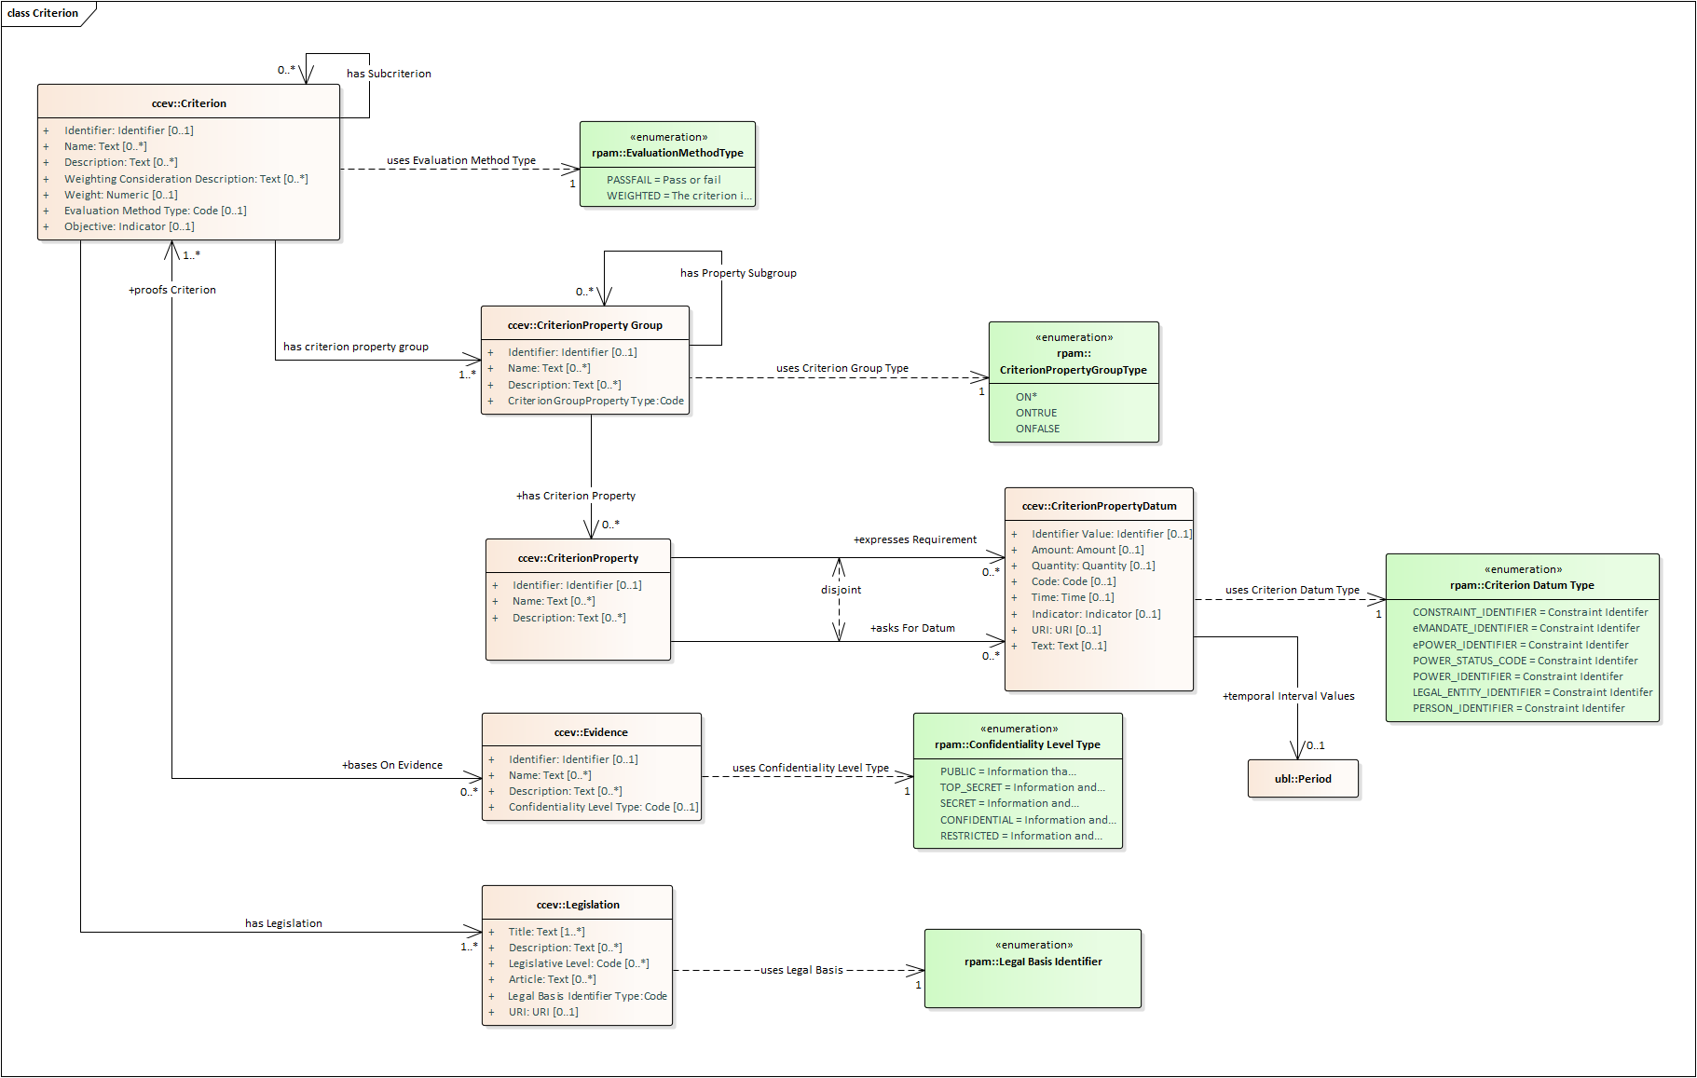
5
Reused ontologies (CCEV)

Slide 17
Next
WG
sessions
8

Slide 18
8
Next Working Group sessions
Next webinars
21st February 14th March 4th April
Communication
GitHub Issues rpam-wg@everis.com

Slide 20
Sample questions
1- Is there any situation where the eMandate (or ePower) would not aim to trigger an eAuthorisation?
2- Is it possible to come up with a set of “harmonised public services?” What would these be? SDGR-based?
3- Would it be possible for a MS to rely on a simple eAuthorisation “OK/KO” returned from the cross-border eMandate Registry, at least for the “harmonised” public services?

